Slide 1
Software Engineering & Professional Practice
Building Usable Software
Dr. Rami Bahsoon
School of Computer Science
University of Birmingham r.bahsoon@cs.bham.ac.uk
Ethics and Professional Practice

Slide 2
Software engineering ethics
Software engineering involves wider responsibilities than simply the application of technical skills.
Software engineers must behave in an honest and ethically responsible way if they are to be respected as professionals.
Ethical behaviour is more than simply upholding the law but involves following a set of principles that are morally correct.
Software Engineering is relatively a young engineering discipline. Many of the ethics discussion in general engineering is still applicable
For orientation: Engineering Ethics Presentation

Slide 3
ACM/IEEE Code of Ethics
The professional societies in the US have cooperated to produce a code of ethical practice.
Members of these organisations sign up to the code of practice when they join.
The Code contains Principles related to the behaviour of and decisions made by professional software engineers, including practitioners, educators, managers, supervisors and policy makers, as well as trainees and students of the profession.
Link to the ACM Code of Ethics

Slide 4
Rationale for the code of ethics
  Computers have a central and growing role in commerce, industry, government, medicine, education, entertainment and society at large. Software engineers are those who contribute by direct participation or by teaching, to the analysis, specification, design, development, certification, maintenance and testing of software systems.
  Because of their roles in developing software systems, software engineers have significant opportunities to do good or cause harm, to enable others to do good or cause harm, or to influence others to do good or cause harm. To ensure, as much as possible, that their efforts will be used for good, software engineers must commit themselves to making software engineering a beneficial and respected profession.
  Presentation: ACM Code Ethics

Slide 5
The ACM/IEEE Code of Ethics
Software Engineering Code of Ethics and Professional Practice
ACM/IEEE-CS Joint Task Force on Software Engineering Ethics and Professional Practices
PREAMBLE
The short version of the code summarizes aspirations at a high level of the abstraction; the clauses that are included in the full version give examples and details of how these aspirations change the way we act as software engineering professionals. Without the aspirations, the details can become legalistic and tedious; without the details, the aspirations can become high sounding but empty; together, the aspirations and the details form a cohesive code.
Software engineers shall commit themselves to making the analysis, specification, design, development, testing and maintenance of software a beneficial and respected profession. In accordance with their commitment to the health, safety and welfare of the public, software engineers shall adhere to the following Eight Principles:

Slide 6
Sample for the ACM Code…
Be honest and trustworthy
  Example: in your practice, reviews of design, code, in testing software systems, competency etc.
Be fair and take action not to discriminate
  Avoid bias when building your team, identifying stakeholders, eliciting requirements, selecting reviewers for your design, setting reasonable milestones to your team etc.)
Strive to achieve high quality in both the processes and products of professional work.
  Example: Careful consideration of dependability issues in design, strive for sustainable processes etc.

Slide 7
Sample for the ACM Code…
Maintain high standards of professional competence, conduct, and ethical practice….
Contribute to society and to human well-being, acknowledging that all people are stakeholders in computing: minimize negative consequences of threats to health, safety, security, and privacy….
Avoid harm…
Accept and provide appropriate professional review…
Give comprehensive and thorough evaluations of computer systems and their impacts, including analysis of possible risks...
Other principles – refer to the handbook

Slide 8
Ethical principles
1. PUBLIC - Software engineers shall act consistently with the public interest.
2. CLIENT AND EMPLOYER - Software engineers shall act in a manner that is in the best interests of their client and employer consistent with the public interest.
3. PRODUCT - Software engineers shall ensure that their products and related modifications meet the highest professional standards possible.
4. JUDGMENT - Software engineers shall maintain integrity and independence in their professional judgment.
5. MANAGEMENT - Software engineering managers and leaders shall subscribe to and promote an ethical approach to the management of software development and maintenance.
6. PROFESSION - Software engineers shall advance the integrity and reputation of the profession consistent with the public interest.
7. COLLEAGUES - Software engineers shall be fair to and supportive of their colleagues.
8. SELF - Software engineers shall participate in lifelong learning regarding the practice of their profession and shall promote an ethical approach to the practice of the profession.

Slide 9
Case studies

Slide 10

Ethical dilemmas?
Disagreement in principle with the policies of senior management.
Your employer acts in an unethical way and releases a safety-critical system without finishing the testing of the system.
Participation in the development of military weapons systems or nuclear systems.
Market pressure and compromises.

Slide 11
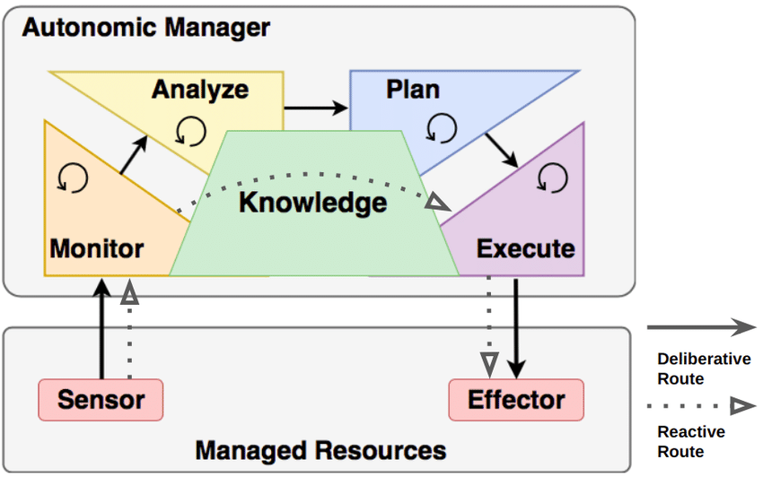
Ethics in Software Engineering of Intelligent Systems: Case of self-driving car
Ethics in Software Engineering of Intelligent Systems
  Architecture choices?
  Compliance: data protection, privacy concerns, etc..
  Ethics in designing and coding intelligent mechanisms designing a control
  Testing and stress testing these systems
  Safety and security of these systems
  Presentation
Software Engineering- R Bahsoon

Slide 12
Real Life Examples
Software Engineering Ethics, Presentation by Zühlke Engineering GmbH (extracts)
  Ethics that relate to data protection
  Ethics that relate to sharing sensitive data information about users
  Ethics that relate to the design of some features: irresponsible design
  Ethics that relate to design out of context and/or not considering various governmental policies
  Ethics that should consider Policies, People, Product and Process (e.g. Responsible Innovation Framework of Marina Jirotka )
Software Engineering- R Bahsoon

Slide 13
References:
Software Engineering, Sommerville
IEEE/ACM Code of Ethics

Slide 14
Issues of professional responsibility
Confidentiality
  Engineers should normally respect the confidentiality of their employers or clients irrespective of whether or not a formal confidentiality agreement has been signed.
Competence
  Engineers should not misrepresent their level of competence. They should not knowingly accept work which is out with their competence.

Slide 15
Issues of professional responsibility
Intellectual property rights
  Engineers should be aware of local laws governing the use of intellectual property such as patents, copyright, etc. They should be careful to ensure that the intellectual property of employers and clients is protected.
Computer misuse
  Software engineers should not use their technical skills to misuse other people’s computers. Computer misuse ranges from relatively trivial (game playing on an employer’s machine, say) to extremely serious (dissemination of viruses).

